Slide 1
Weeks 7-8 Progress
Audrey Robison
Advisor: Dr. Jiong Qiu
MSU REU Summer 2022

Slide 2
Goals of the Study
Measurement of Reconnection Rate
Measurement of Reconnection Shear
Notes:
My two goals for this project are to measure the rate and shear of magnetic reconnection. The rate is the change of flux over time within a solar flare. The shear is a geometric property describing the angle at which the loops reconnect.

Slide 3
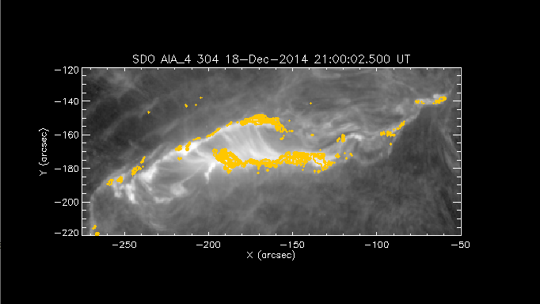
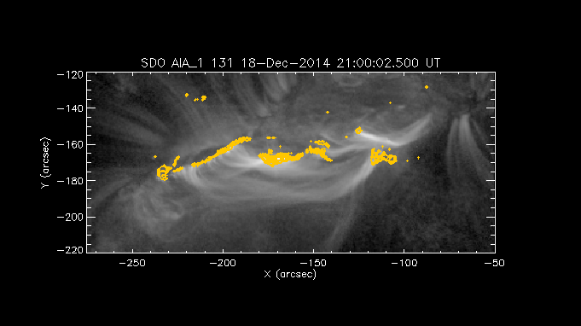
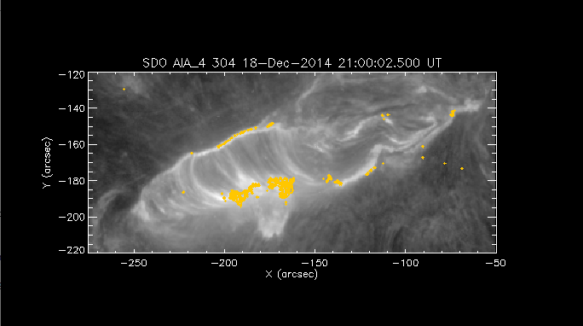
Preliminary Results
Three phases of Flare Evolution
High Shear
Rapid Expansion
Slow Expansion
Phase 2
Phase 1
Phase 3

Slide 4
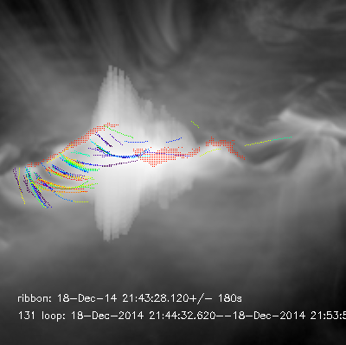
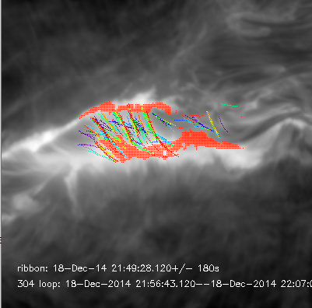
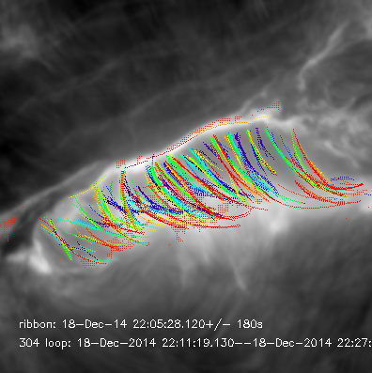
Quantitative Confirmation of Shear Data
Stage 1 , 131 : high shear
Stage 2, 304: rapid expansion I
Stage 4, 304: slow expansion I

Slide 5
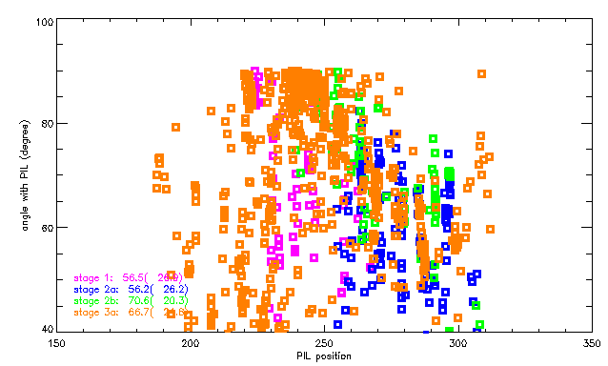
Angle with PIL Scatterplot

Slide 6
Next Steps
Comparison of angle of extrapolated loops with the PIL

